Slide 1
Project #1: Drug Kinetics in Genetically Modified Mice

Slide 2




Model
Initial dose: ${X_{a}(0)=X}_{0}∙F$, where $F$ is the fraction of drug absorbed.
$$k_{a}$$
$$K$$
$$X_{a}$$
$$X$$
Absorption compartment: Blood (plasma) compartment:
total drug amount total drug amount
Here $k_{a}$ is absorption rate constant and $K$is drug elimination rate constant.

Slide 3
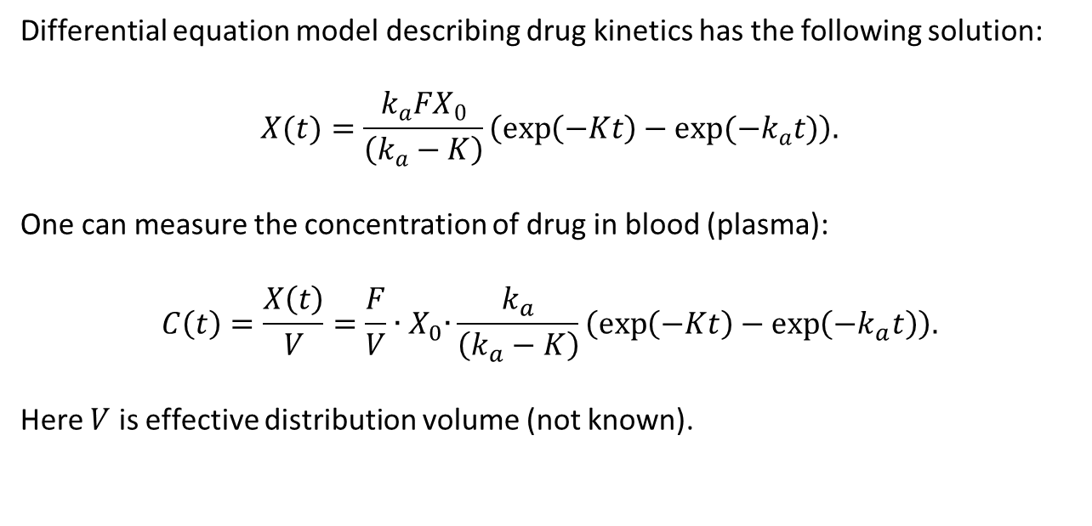
Differential equation model describing drug kinetics has the following solution:
$$X(t)=\frac{k_{a}FX_{0}}{\left(k_{a}−K\right)}\left(\exp\left(−Kt\right)−exp(−k_{a}t)\right).$$
One can measure the concentration of drug in blood (plasma):
$$C\left(t\right)=\frac{X\left(t\right)}{V}=\frac{F}{V}{∙X}_{0}∙\frac{k_{a}}{\left(k_{a}−K\right)}\left(\exp\left(−Kt\right)−\exp\left(−k_{a}t\right)\right).$$
Here $V$ is effective distribution volume (not known).

Slide 4
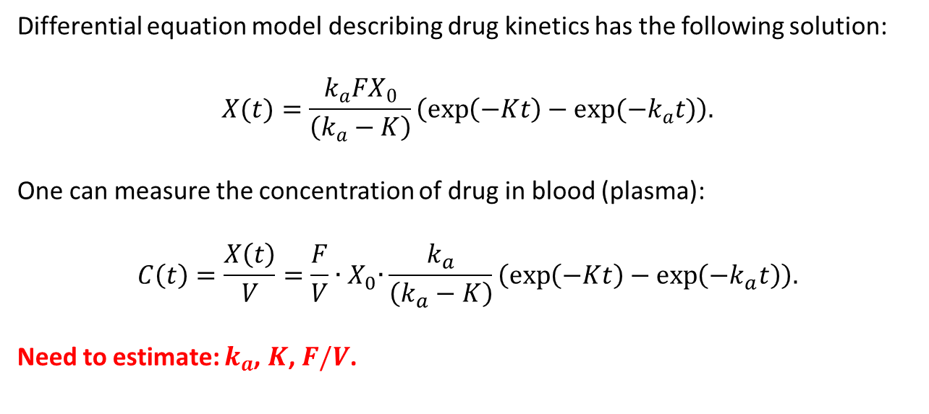
Differential equation model describing drug kinetics has the following solution:
$$X(t)=\frac{k_{a}FX_{0}}{\left(k_{a}−K\right)}\left(\exp\left(−Kt\right)−exp(−k_{a}t)\right).$$
One can measure the concentration of drug in blood (plasma):
$$C\left(t\right)=\frac{X\left(t\right)}{V}=\frac{F}{V}{∙X}_{0}∙\frac{k_{a}}{\left(k_{a}−K\right)}\left(\exp\left(−Kt\right)−\exp\left(−k_{a}t\right)\right).$$
Need to estimate: $k_{a}$, $K$, $F/V$.

Slide 5
Data: Mice A
 | drug concentration in plasma: microgram/ml
 | t=1h | t=2h | t=4h | t=8h |  |  | initial dose: micrograms
mouse1a | 26.97792 | 19.75837 | 12.76016 | 4.434793 |  |  | 31.43448
mouse2a | 24.24753 | 22.72409 | 13.30686 | 4.812059 |  |  | 33.26047
mouse3a | 24.77666 | 20.56166 | 11.41168 | 4.557679 |  |  | 30.97779
mouse4a | 22.64532 | 19.94236 | 11.72876 | 4.045205 |  |  | 32.06939
mouse5a | 21.28494 | 17.78286 | 8.705149 | 4.453663 |  |  | 31.45377
mouse6a | 25.03974 | 16.68711 | 11.45587 | 4.022986 |  |  | 29.39312
mouse7a | 23.85169 | 20.79003 | 8.796537 | 4.48717 |  |  | 30.58774
mouse8a | 22.04373 | 14.48006 | 8.041883 | 4.058295 |  |  | 28.42543
mouse9a | 27.03642 | 19.25051 | 11.79822 | 4.692525 |  |  | 31.77679
mouse10a | 22.88891 | 13.54645 | 9.237231 | 3.70474 |  |  | 27.70586

Slide 6
Data: Mice B
 | drug concentration in plasma: microgram/ml
 | t=1h | t=2h | t=4h | t=8h |  |  | initial dose: micrograms
mouse1b | 18.22752 | 10.02384 | 4.593106 | 0.496992 |  |  | 29.49211
mouse2b | 17.73821 | 8.203042 | 3.365571 | 0.493685 |  |  | 27.14271
mouse3b | 17.71877 | 13.10216 | 4.383508 | 0.568575 |  |  | 29.95828
mouse4b | 20.32763 | 10.00664 | 4.03902 | 0.482287 |  |  | 28.87867
mouse5b | 19.88525 | 12.80134 | 4.552165 | 0.612637 |  |  | 34.35556
mouse6b | 20.26879 | 12.57416 | 3.916291 | 0.6134 |  |  | 32.27693
mouse7b | 16.21579 | 9.327095 | 3.296307 | 0.374859 |  |  | 25.00623
mouse8b | 18.93819 | 10.35912 | 4.153664 | 0.625798 |  |  | 30.88265
mouse9b | 17.99845 | 9.563525 | 3.148519 | 0.620605 |  |  | 27.20372
mouse10b | 18.51092 | 10.74009 | 4.077918 | 0.593429 |  |  | 29.48989

Slide 7
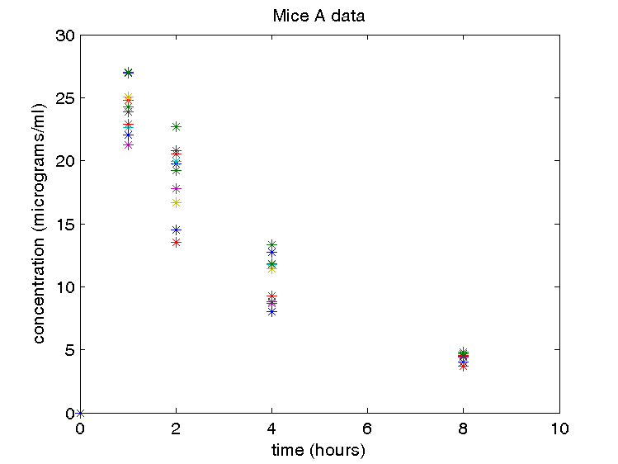

Slide 8
